Slide 1
01
INTRODUCTION

Slide 2
PART ONE
01
02
03
What is a CubeSat?
Applications of CubeSats
System Overview
CubeSat definition and standards
What CubeSats help us achieve
The overall structure of the CubeSat system

Slide 3
What is a CubeSat
Began as a collaborative effort in 1999.
Original intent was to provide affordable access to space.
Universities and schools started CubeSat programs of their own.

Slide 4
What is a CubeSat
A CubeSat must conform to specific criteria in its shape, size, and weight.
A 1U CubeSat is a 10 cm cube with a mass of approximately 1 to 1.33 kg.
Larger sizes have become popular, such as the 1.5U, 2U, 3U, 6U, and 12U.

Slide 5
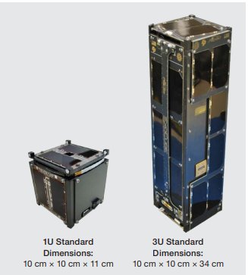
The opposite figure shows a 1 U CubeSat (left) and a 3U CubeSat (right).

Slide 6
What is a CubeSat?
(Brief History)
The first six cubesats were launched in June 2003 from Russia's Plesetsk launch site. The going rate for a CubeSat's launch was about $40,000, which is a bargain compared to a typical satellite (many are millions of dollars.)
The ongoing miniaturization of electronics were key factors in the realization of CubeSats.
For the first decade, most cubesats that flew came from university or research applications.
In 2013, the number of launches suddenly numbered in the dozens. It was in that year that the commercial sector began to launch satellites.

Slide 7
1,600
As of August 2021, more than 1,600 CubeSats have been launched

Slide 8
Applications of CubeSats
For 19 years, CubeSats have been used exclusively in Low-Earth Orbit (LEO). Now, they are being used for interplanetary missions too. Their applications include:
1. Improved science, technology, engineering, and math (STEM) education through hands-on learning opportunities in aerospace engineering.
2. New types of research: Standard satellites are used for low-risk missions. CubeSats, can be used for exploratory, high-risk research.

Slide 9
Applications of CubeSats
3. Weather forecasts, Earth exploration, and space research. Now, interplanetary missions too.
4. Accelerated innovation: CubeSats enable new users from across different disciplines to contribute their ideas and unique skill sets to small satellite design.
5. Public engagement: CubeSats’ accessibility allows members of the public more autonomy over the research questions they address.

Slide 10
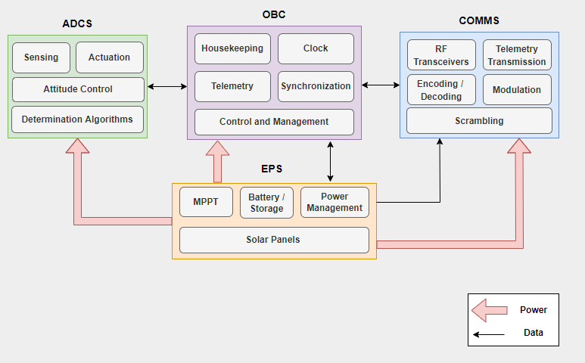
System Overview
The CubeSat is composed of four main subsystems that are necessary for its basic functions.
EPS is the most vital subsystem that provides the power management functionality. It is mainly responsible for the power storage, supply and management for the CubeSat.

Slide 11
System Overview
The OBC (On-Board Computer) is the brain of the CubeSat. It is responsible for the control and management of the CubeSat, and for collecting its status information.

Slide 12
System Overview
The Attitude Detection and Control Subsystem (ADCS) manages the position of the CubeSat in space through determining the position parameters, reading sensors, and controlling and actuating accordingly.

Slide 13
System Overview
The Communications Subsystem (COMMS) is responsible for the communication with the GS. It sends regular CubeSat status information, and receives commands from the GS regarding actions that are required to be taken on the CubeSat.

Slide 14
THANKS!
Do you have any questions? youremail@freepik.com +91620421838 yourwebsite.com
Please keep this slide for attribution

